Slide 1
CA2 Growth of Digital Games
By jack nulty

Slide 2
Introduction
The gaming industry has experienced massive growth over the past few decades with the rise of Steam we see the rise of digital games and playing a pivotal role in how games are published and distributed.
This report leverages the Steam Games Dataset 2025 which includes key information for games such as release dates genre tags and publisher information.
I will talk about a set of research questions and present my findings in graphs and key points.

Slide 3
Research Questions
1. How does the frequency / number of DLC’s for a game effect user reviews?
2. How does the pricing of games affect user reviews?
3. What genres have had trending growth over the years?
4. How has the AAA landscape changed over the years?

Slide 4
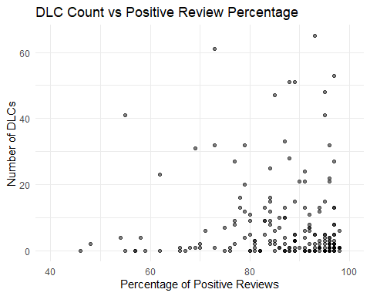
How does the frequency / number of DLC’s for a game effect user reviews?
There is a general disconnect between the number of DLCs and the number of positive reviews.
Games with very high review percentages often have fewer DLCs. This suggests developers of well-reviewed games may offer continued support without excessive monetization.
Some games with many DLCs have lower review percentages. This could indicate that these games are being monetized heavily ("milked") without quality improvements.

Slide 5
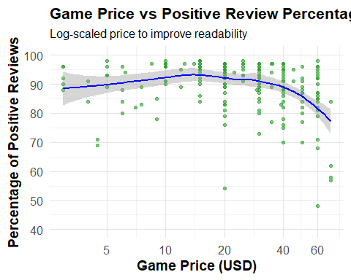
How does the pricing of games affect user reviews?
There is a non-linear relationship between game price and positive review percentage.
Very cheap games tend to have slightly lower positive review percentages than mid-range priced games ($20–$30).
Games priced above $30 often receive harsher reviews, possibly due to higher player expectations.
Outliers exist across all price ranges, with some low-rated games at every price point.
In general, game price impacts player perception and forgiveness for flaws—higher prices may lead to less leniency.

Slide 6
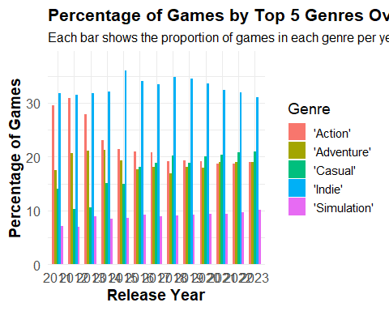
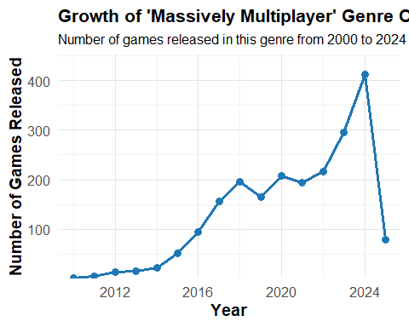
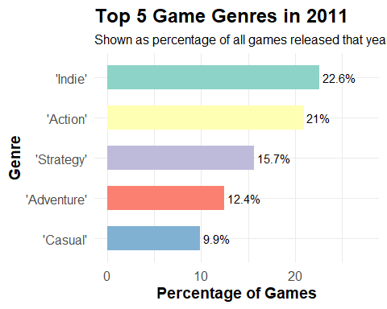
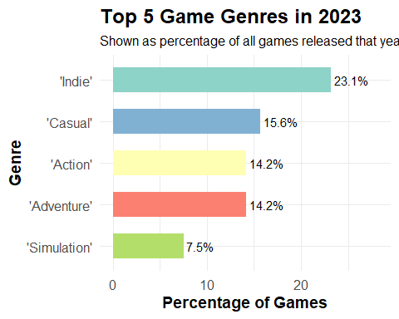
What genres have had trending growth over the years?
Action games dominated the early 2010s but have slightly declined in recent years.
Casual games have risen in popularity, reflecting the growth of the gaming industry and the influx of casual players. This shift indicates developers are increasingly targeting the casual market.
Indie games have consistently been released in large numbers, showing steady interest from smaller developers
Massively Multiplayer games have grown in popularity recently, likely due to advances in computational power and internet speeds.

Slide 7


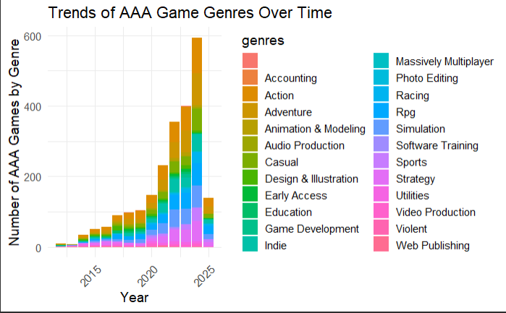
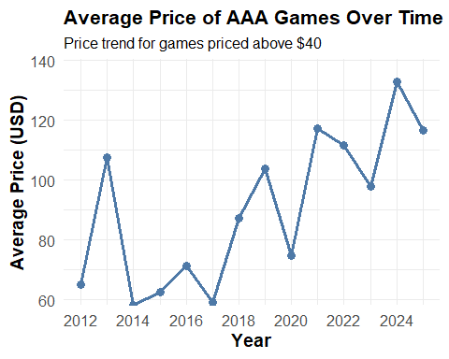
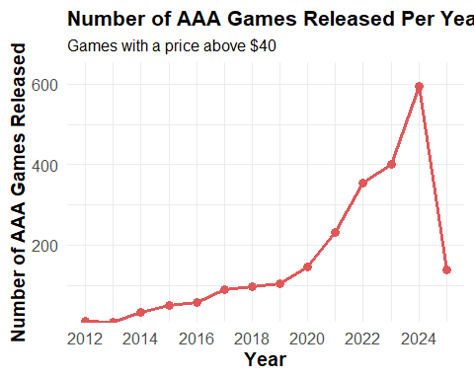
How has the AAA landscape changed over the years?
The AAA game landscape has evolved significantly over the years.
There's been a steady increase in the number of AAA games released annually.
Game prices have risen, especially with the launch of PS5 and Xbox Series X, reaching €70 per game.
This price hike has led to backlash from players who feel the value doesn’t match the cost.
This trend aligns with earlier findings on how game pricing affects user reviews.
AAA genres have shifted, with a rise in Massively Multiplayer and live-service games.
These models are often used to maximize long-term profit and player retention, reflecting studios' focus on revenue and shareholder interests.

Slide 8
Conclusions
The report analyzed various factors in digital game development and distribution using the Steam Games dataset.
More DLC does not guarantee better reviews; moderate post-launch support is often tied to higher-rated games.
Pricing has a non-linear relationship with reviews:
Mid-priced games tend to receive better reviews.
Very cheap or very expensive games are often rated more harshly.
Genre evolution reflects broader industry shifts:
Persistent presence of action and indie titles.
Casual games rose with the influx of new/mobile gamers.
Massively multiplayer genres gained popularity with tech advancements.
The AAA market has evolved:
Higher prices bring higher player expectations and criticism.
Studios increasingly adopt live-service models for monetization.
There's growing tension between profit-driven strategies and player value.
Overall, the findings highlight how data can help developers, publishers, and gamers navigate the evolving industry landscape.

Slide 9
Reference
Steam Games Dataset 2025: [Steam Games Dataset](https://www.kaggle.com/datasets/nikhilroxtomar/steam-games-dataset-2025)

